Slide 1



Airline Booking System Team Members: Gadila Akshitha Inshita Bamba Sujay Reddy Yaramala Jyothi Poshetty Ramsagar Varsha Lokesh Maddipoti Muppalla Siva Rama Krishna Bala Mahesh Chilakala NALLA ANJANEYULU KILARI MANJUNATH Indukuri Pranav Varma

Slide 2
Content
Introduction
Problem Statement
System Requirements
Technology Used
Glimpse of website

Slide 3

Introduction
Airline reservation systems are systems that allow an airline to sell their inventory (seats). It contains information on schedules and fares and contains a database of reservations (or passenger name records) and of tickets issued .

Slide 4
Problem Statement
A newly launched airline is looking to automate its flight booking system using the latest technology stack and enable its customers to book/reschedule/cancel flights all on their own. It will help them cut costs by reducing the pressure on airline operations staff and can scale as the airline increases its footprint across multiple cities.
The airline is looking to develop an application which can be accessed on various devices and will allow the users to book a fresh flight, cancel or reschedule existing ones for various flights available across cities. The application should have the following capabilities apart from the obvious ones:
Register a user
Previous bookings
Master passenger list per user
Payments (mocked version)

Slide 5
System Requirements
Customers should be able to reserve a ticket for any scheduled flight. Customers can also build a multi-flight itinerary.
Users of the system can check flight schedules, their departure time, available seats, arrival time, and other flight details.
Customers can make reservations for multiple passengers under one itinerary.
Customers can cancel their reservation and itinerary. The system should be able to handle payments for reservations.
The system should be able to send notifications to customers whenever a reservation is made/modified or there is an update for their flights.

Slide 6

Technology Used
Front-End :
HTML
CSS
JavaScript
Back-End :
MongoDB
Node.js

Slide 7
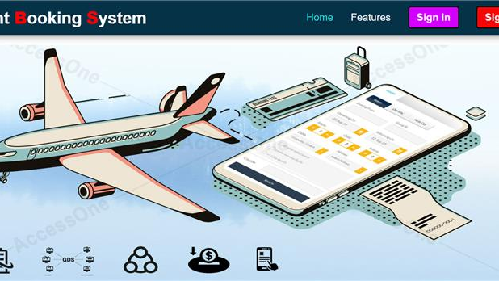
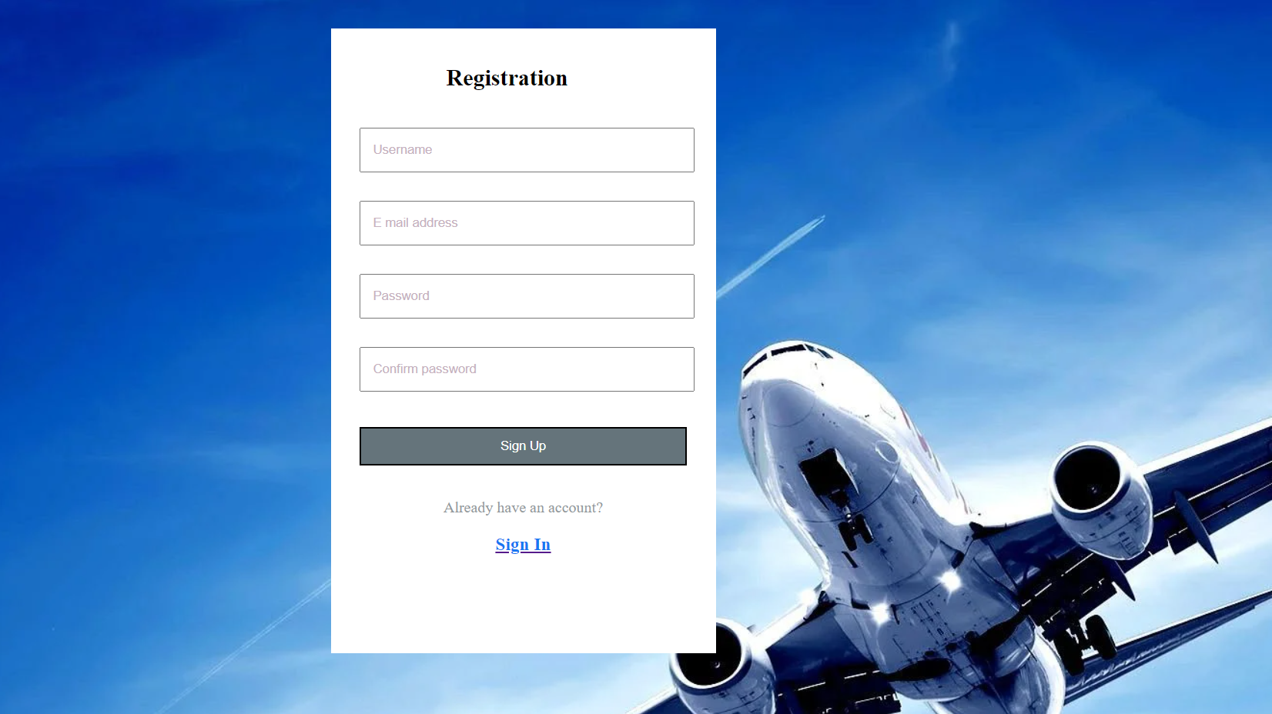

Glimpse of Website

Slide 8
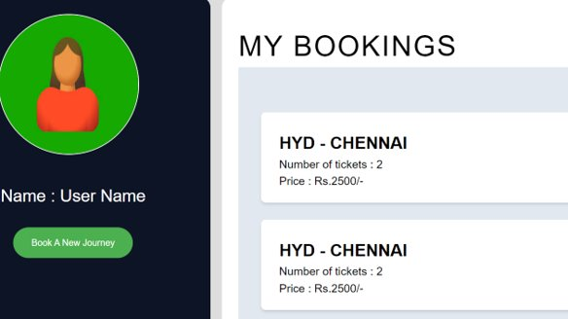

Slide 9
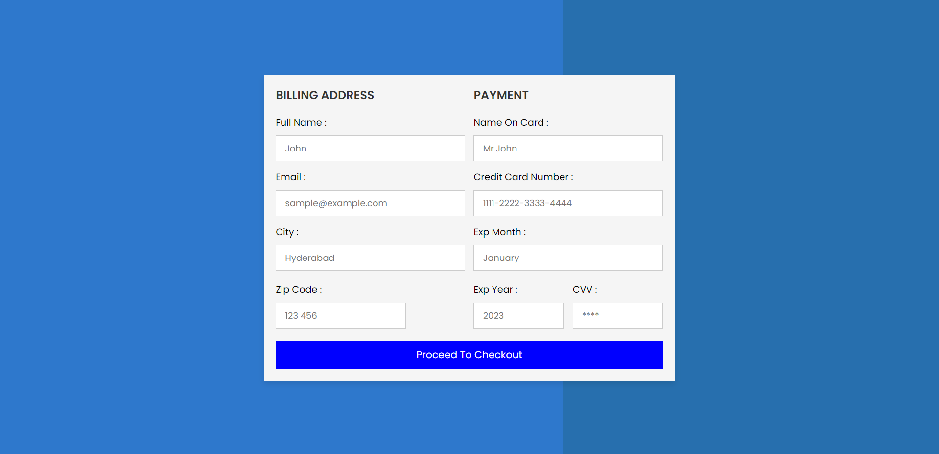

Slide 10
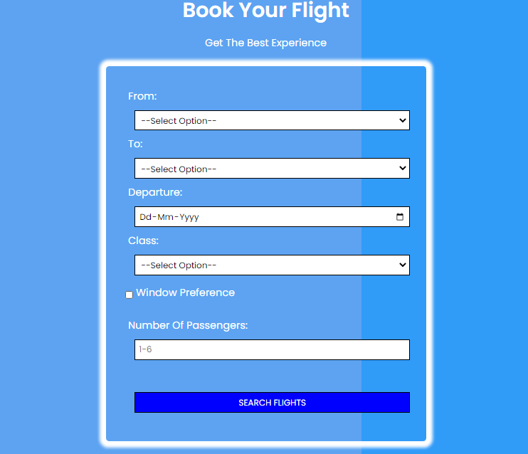

Slide 11


